Slide 1

School Database
Presentation

Slide 2
Team members:
Mariam Khaled Ramadan “Section 6”
Mariam Ashraf Mohammed “Section 6”
Mora Montasser Khalf ”Section 7”
Mariam Salman Sedky “Section 6”
Mariam Mahmoud Mohamed ”Section 6 ”

Slide 3
Tables:
Students table
Teachers table student’s grade table
Classes table
Levels table
Subjects table

Slide 4
This database is designed to make the school management system much easier with the tools that it provides. To make the educational system easier and faster to process.
It contains some good user-friendly forms to boost the data entry process. Hopefully it will be useful !!!

Slide 5
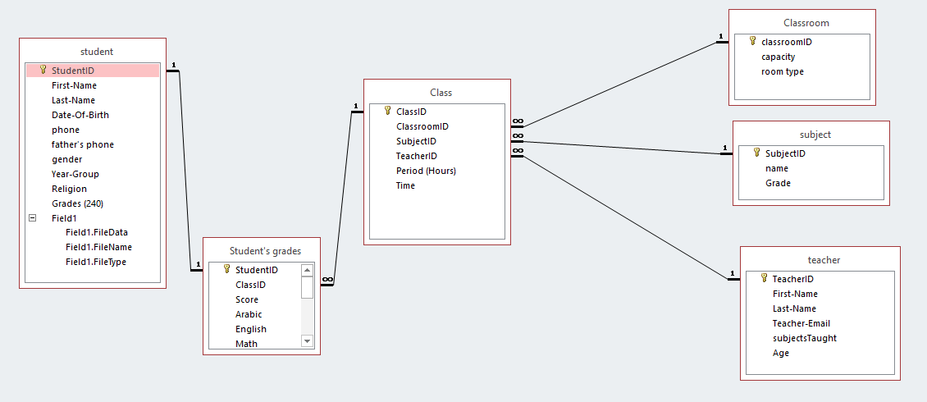
ERD

Slide 6
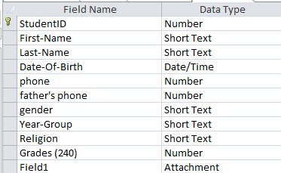
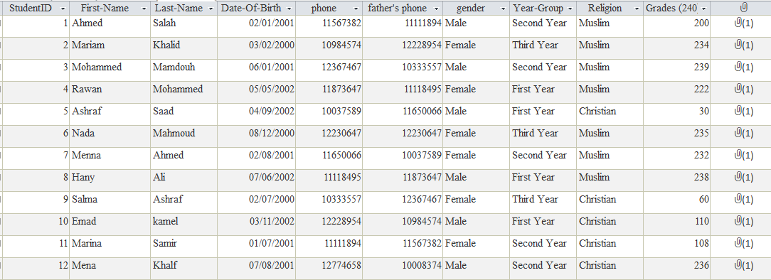
Student Table

Slide 7
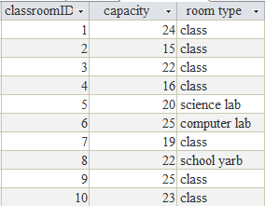
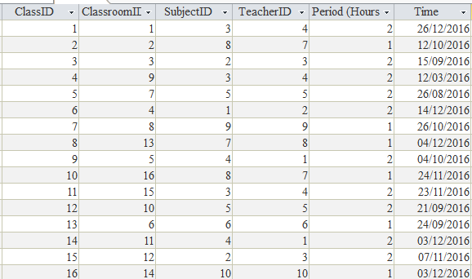
class Table
Teacher table

Slide 8
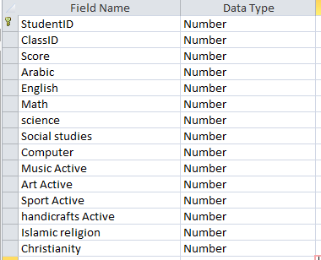
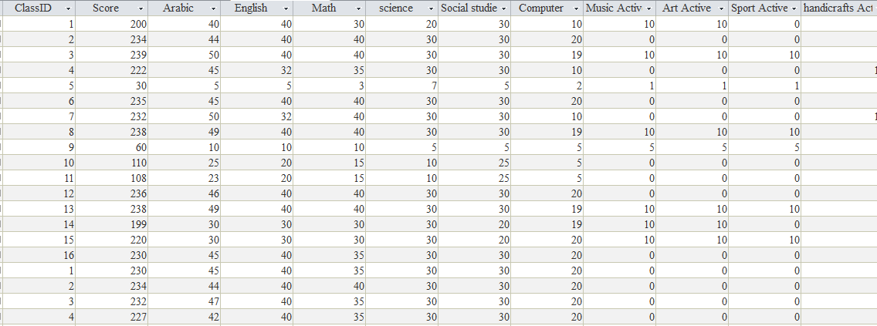
Score of student in each subject

Slide 9
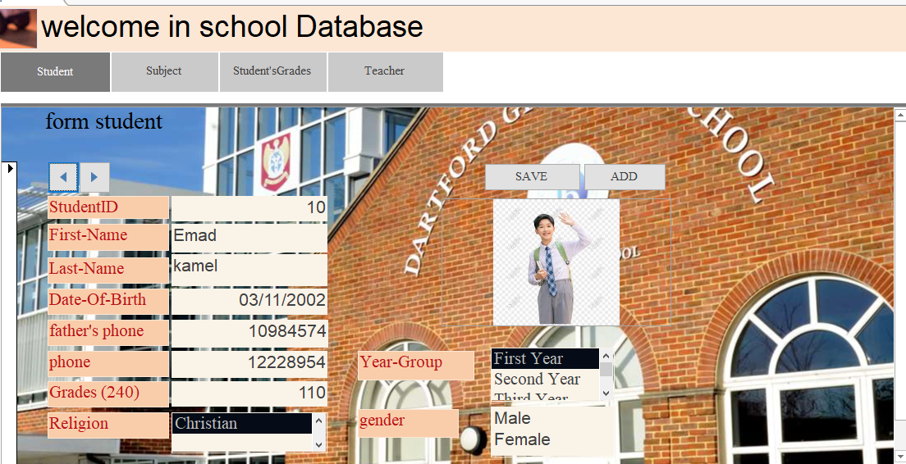
Photos from the user interface (Forms):

Slide 10
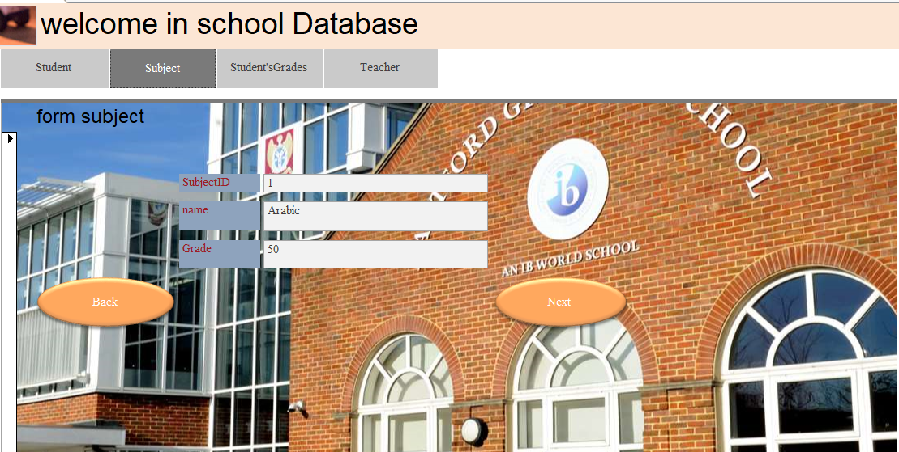
Photos from the user interface (Forms):

Slide 11
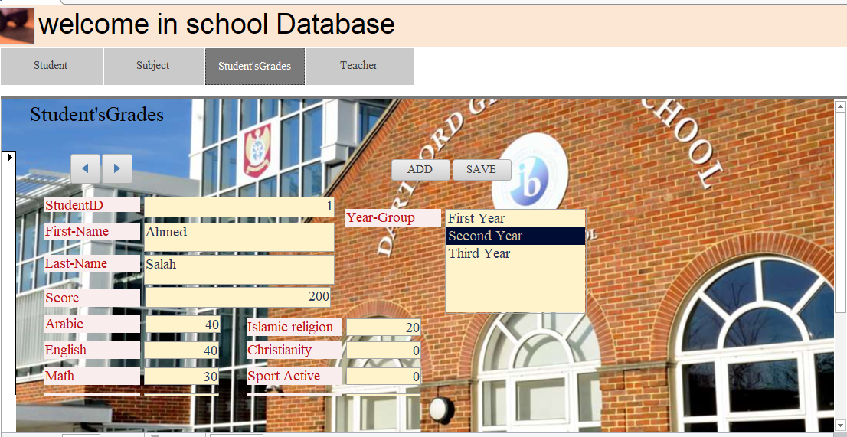
Photos from the user interface (Forms):

Slide 12
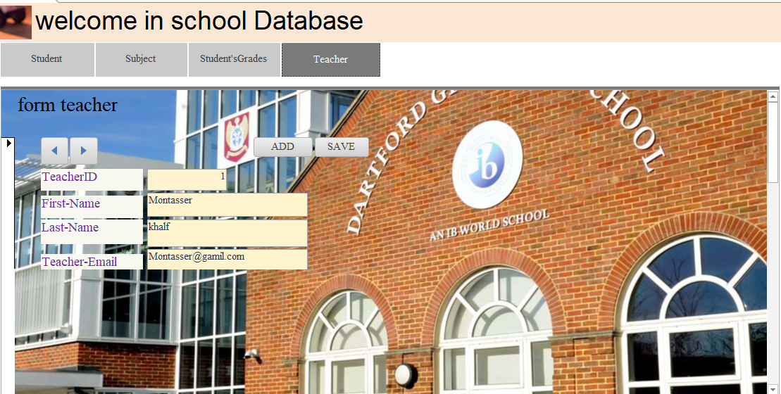
Photos from the user interface (Forms):

Slide 13
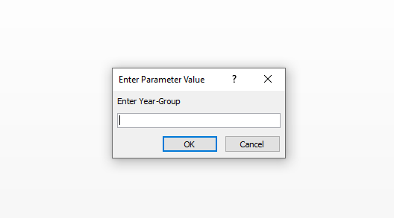
Query
Show the top student and another to show repeater student

Slide 14
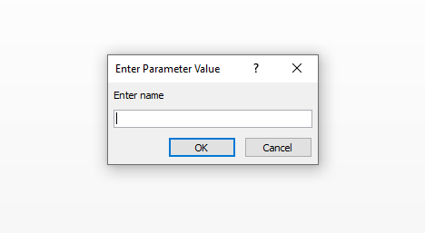
Query
Delete student and another delete teacher

Slide 15
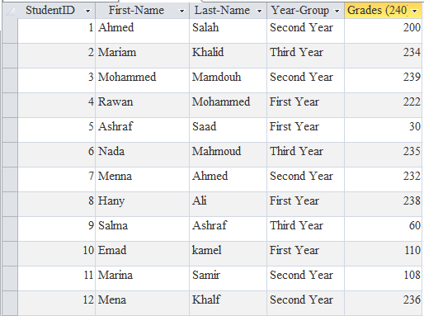
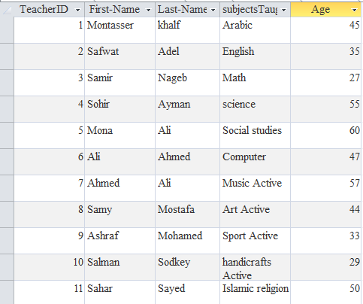
Query update student and another to update teacher

Slide 16
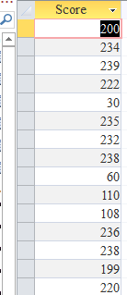
Query calculate score by summation all subject grade

Slide 17
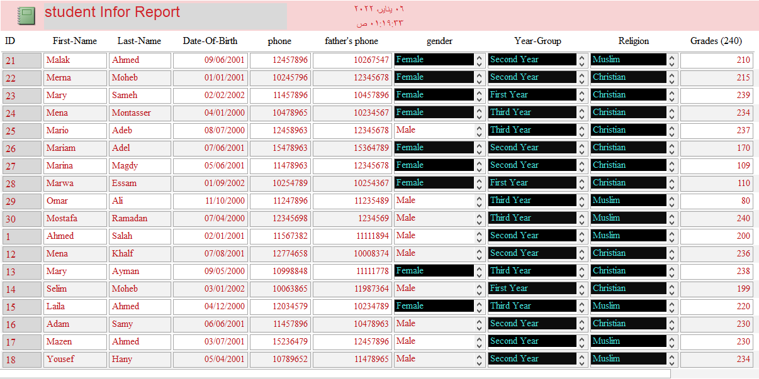
Report

Slide 18
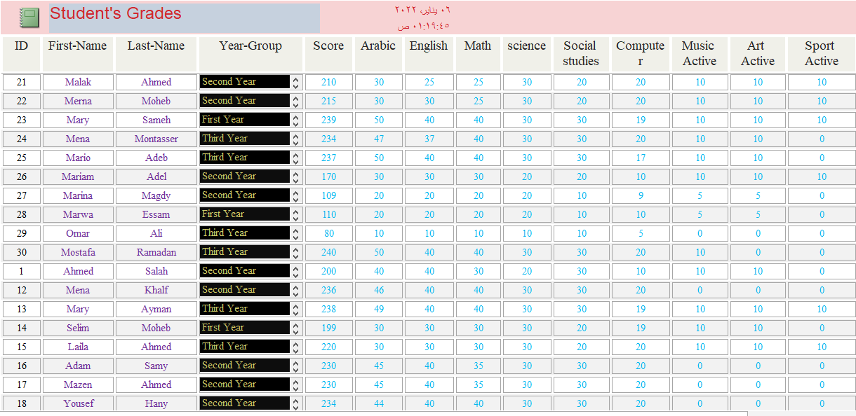
Report

Slide 19
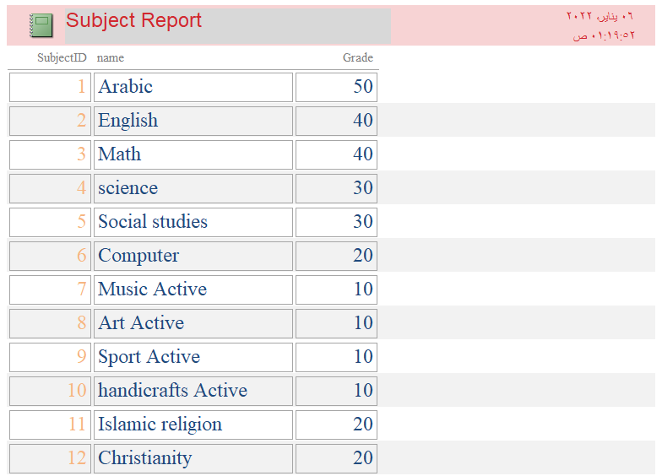
Report

Slide 20
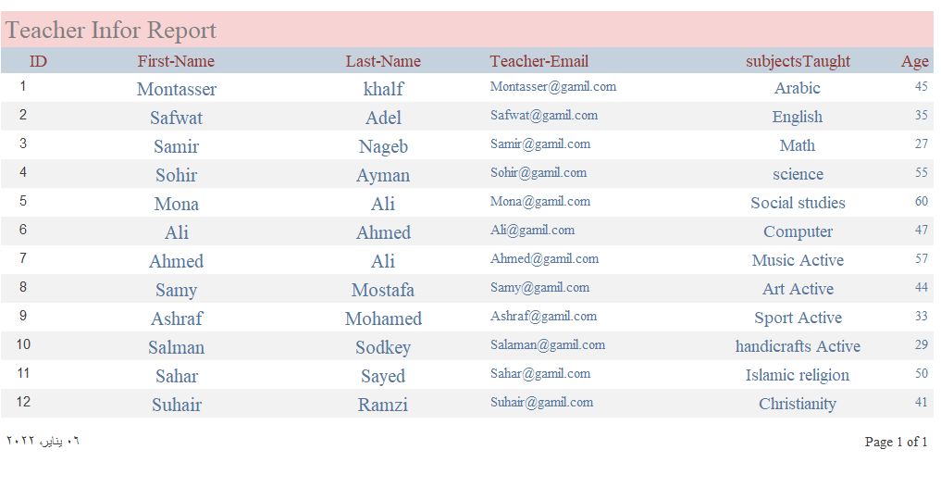
Report

